Slide 1


Amazon Web Services – Data Analytics
S3 – Simple Storage Service

Slide 2

By the end of this lesson, you will be able to:
Introduction to AWS S3
Create and Manage Buckets
Data Storage and Retrieval
Object Operations – Uploading, Downloading
Versioning
Data Management
Storage Classes
Lifecycle Management
Transfer Acceleration
AGENDA

Slide 3

What is Amazon S3 – Simple Storage Service
Amazon S3 (Simple Storage Service) provides object storage, which is built for storing and recovering any amount of information or data from anywhere over the internet.
It provides this storage through a web services interface.
While designed for developers for easier web-scale computing, it provides 99.999999999 percent durability and 99.99 percent availability of objects.
It can also store computer files up to 5 terabytes in size.

Slide 4
Amazon S3 – Advantages
1
Create Buckets
2
Storing data in buckets
3
Download data
4
Permissions
5
Standard interfaces
6
Security

Slide 5
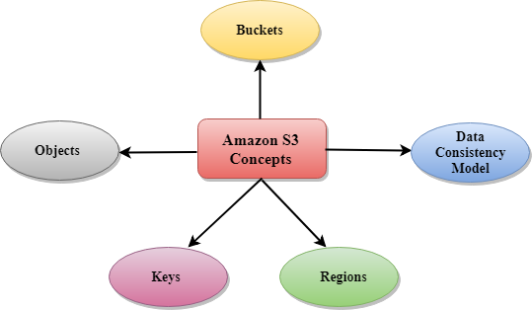
Amazon S3 – Concepts
Buckets : A bucket is a container used for storing the objects.
Objects : Objects are the entities which are stored in an S3 bucket.
Keys : A key is a unique identifier for an object.
Regions : You can choose a geographical region in which you want to store the buckets that you have created.
Data Consistency : Amazon S3 replicates the data to multiple servers to achieve high availability.

Slide 6
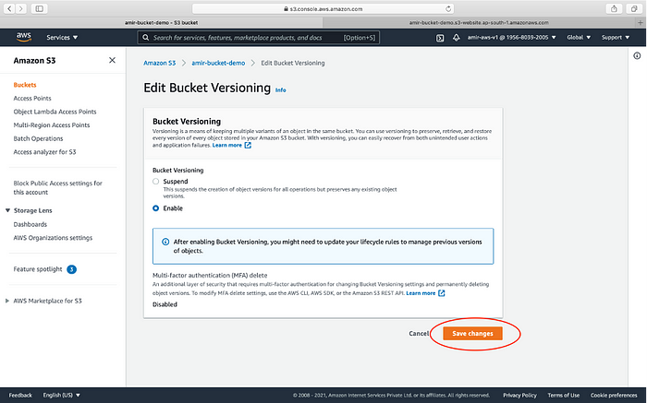
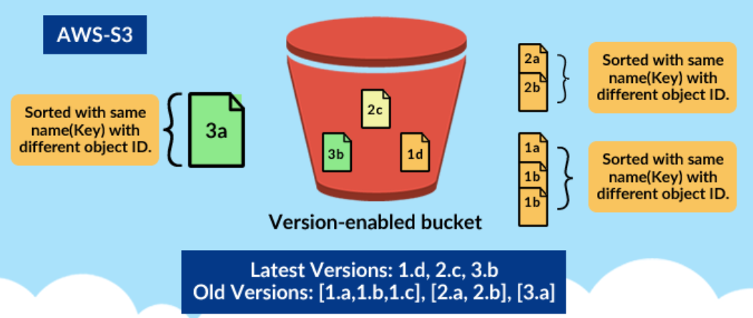
Amazon S3 – Versioning
You can version your files in Amazon S3
It is enabled at the Bucket Level
Same key overwrite will increment the "versions":1,2,3.....
It is best practice to version your buckets
Protect against unintended deletes
It ability to restore a version
Easy roll back to previous version

Slide 7
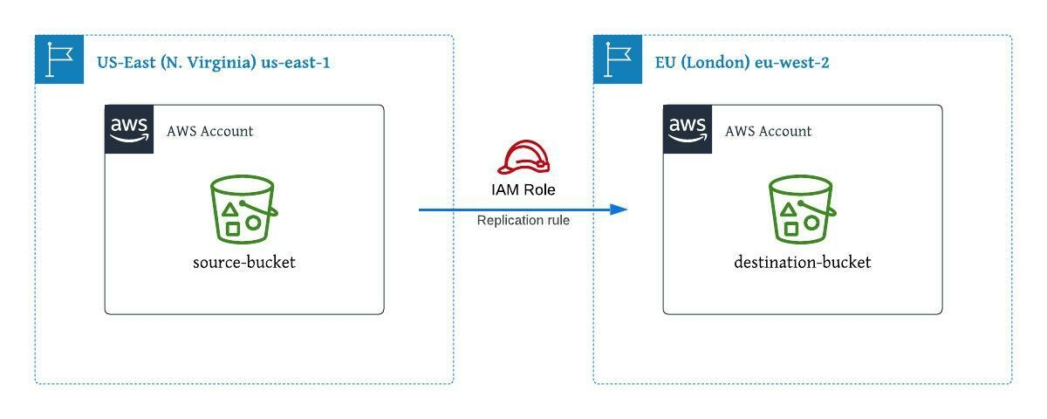
Amazon S3 – Cross Region Replication
Cross Region Replication is a feature that replicates the data from one bucket to another bucket which could be in a different region.
It provides asynchronous copying of objects across buckets.
Suppose X is a source bucket and Y is a destination bucket.
If X wants to copy its objects to Y bucket, then the objects are not copied immediately.

Slide 8




Amazon S3 – Storage Class
1
2
3
4
S3 Standard
S3 Standard IA
S3 one zone - infrequent access
S3 Glacier

Slide 9
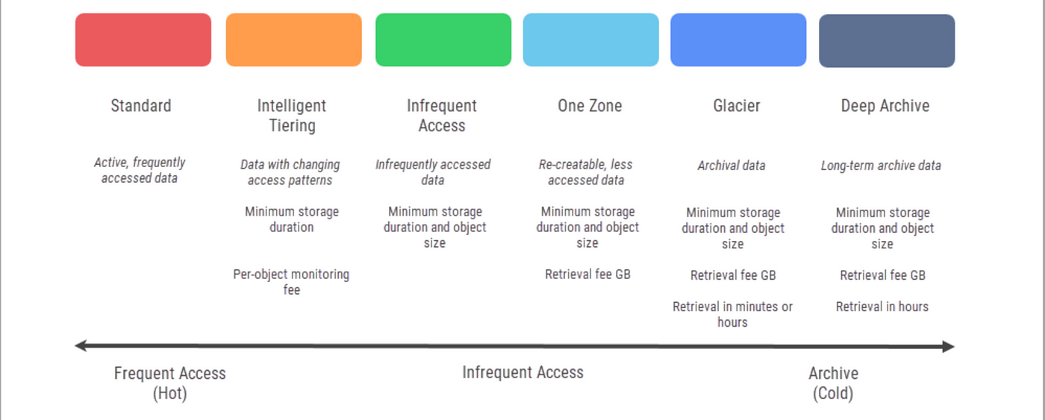
Amazon S3 – Storage Class

Slide 10
Amazon S3 – Storage Class
Performance across the Storage classes
 | S3 Standard | S3 Standard IA | S3 One Zone-IA | S3 Glacier
Designed for durability | 99.99999999% | 99.99999999% | 99.99999999% | 99.99999999%
Designed for availability | 99.99% | 99.9% | 99.5% | N/A
Availability SLA | 99.9% | 99% | 99% | N/A
Availability zones | >=3 | >=3 | 1 | >=3
Minimum capacity charge per object | N/A | 128KB | 128KB | 40KB
Minimum storage duration charge | N/A | 30 days | 30 days | 90 days
Retrieval fee | N/A | per GB retrieved | per GB retrieved | per GB retrieved
First byte latency | milliseconds | milliseconds | milliseconds | Select minutes or hours
Storage type | Object | Object | Object | Object
Lifecycle transitions | Yes | Yes | Yes | Yes

Slide 11
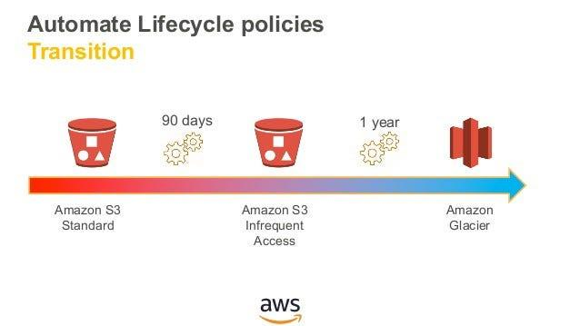
Amazon S3 – Lifecycle management
Lifecycle Management is used so that objects are stored cost-effectively throughout their lifecycle.
A lifecycle configuration is a set of rules that define the actions applied by S3 to a group of objects.
An S3 Lifecycle Management in simple terms when in an S3 bucket some data is stored for a longer time in standard storage even when not needed.
The need to shift this old data to cheaper storage or delete it after a span of time gives rise to life cycle management.
There are 2 types of actions: Transition actions & Expiration actions

Slide 12
QUIZ Time!!
What is the primary purpose of Amazon S3?
To run containerized applications
To store and retrieve any amount of data at any time
To deploy machine learning model.
To provide relational database services
Notes:
It’s Quiz Time!
Please read the question carefully and check all the options given. Pause the video for 10 seconds and answer the question.
Which of the following applications use AI?
Is it the gram (or the instagram)?
Or is it YouTube?
Is it the net banking application of your bank?
or is it the Anti-virus software installed in your computer or phone?
Which one of these leverage AI?

Slide 13

QUIZ Time!!
What is the primary purpose of Amazon S3?
To run containerized applications
To store and retrieve any amount of data at any time
To deploy machine learning model.
To provide relational database services
Notes:
It’s Quiz Time!
Please read the question carefully and check all the options given. Pause the video for 10 seconds and answer the question.
Which of the following applications use AI?
Is it the gram (or the instagram)?
Or is it YouTube?
Is it the net banking application of your bank?
or is it the Anti-virus software installed in your computer or phone?
Which one of these leverage AI?

Slide 14
QUIZ Time!!
Which of the following is NOT a valid storage class in Amazon S3?
S3 Standard
S3 Intelligent-Tiering
S3 Standard-IA
S3 Premium
Notes:
It’s Quiz Time!
Please read the question carefully and check all the options given. Pause the video for 10 seconds and answer the question.
Which of the following applications use AI?
Is it the gram (or the instagram)?
Or is it YouTube?
Is it the net banking application of your bank?
or is it the Anti-virus software installed in your computer or phone?
Which one of these leverage AI?

Slide 15
QUIZ Time!!
Which of the following is NOT a valid storage class in Amazon S3?
S3 Standard
S3 Intelligent-Tiering
S3 Standard-IA
S3 Premium
Notes:
It’s Quiz Time!
Please read the question carefully and check all the options given. Pause the video for 10 seconds and answer the question.
Which of the following applications use AI?
Is it the gram (or the instagram)?
Or is it YouTube?
Is it the net banking application of your bank?
or is it the Anti-virus software installed in your computer or phone?
Which one of these leverage AI?

Slide 16
QUIZ Time!!
How can you secure your data in Amazon S3 at rest?
By enabling server-side encryption (SSE)
By using IAM policies
By setting up bucket policies
By enabling versioning
Notes:
It’s Quiz Time!
Please read the question carefully and check all the options given. Pause the video for 10 seconds and answer the question.
Which of the following applications use AI?
Is it the gram (or the instagram)?
Or is it YouTube?
Is it the net banking application of your bank?
or is it the Anti-virus software installed in your computer or phone?
Which one of these leverage AI?

Slide 17
QUIZ Time!!
How can you secure your data in Amazon S3 at rest?
By enabling server-side encryption (SSE)
By using IAM policies
By setting up bucket policies
By enabling versioning
Notes:
It’s Quiz Time!
Please read the question carefully and check all the options given. Pause the video for 10 seconds and answer the question.
Which of the following applications use AI?
Is it the gram (or the instagram)?
Or is it YouTube?
Is it the net banking application of your bank?
or is it the Anti-virus software installed in your computer or phone?
Which one of these leverage AI?

Slide 18
QUIZ Time!!
Which feature of Amazon S3 allows you to recover from unintended user actions and application failures?
S3 Transfer Acceleration
S3 Cross-Region Replication
S3 Versioning
S3 Glacier
Notes:
It’s Quiz Time!
Please read the question carefully and check all the options given. Pause the video for 10 seconds and answer the question.
Which of the following applications use AI?
Is it the gram (or the instagram)?
Or is it YouTube?
Is it the net banking application of your bank?
or is it the Anti-virus software installed in your computer or phone?
Which one of these leverage AI?

Slide 19
QUIZ Time!!
Which feature of Amazon S3 allows you to recover from unintended user actions and application failures?
S3 Transfer Acceleration
S3 Cross-Region Replication
S3 Versioning
S3 Glacier
Notes:
It’s Quiz Time!
Please read the question carefully and check all the options given. Pause the video for 10 seconds and answer the question.
Which of the following applications use AI?
Is it the gram (or the instagram)?
Or is it YouTube?
Is it the net banking application of your bank?
or is it the Anti-virus software installed in your computer or phone?
Which one of these leverage AI?

Slide 20
Key takeaways
Security and Compliance
Data Management and Analytics
Lifecycle Policies and Versioning
Integration with AWS Services
1
3
5
7
2
4
6
8
Easy-to-Use Object Storage
Cost-Effective Storage Classes
High Availability and Durability
Scalability and Performance

Slide 21
THANK YOU

